Slide 1
Kitware IODA Mid-Term Review Julien Jomier, Kitware SAS julien.jomier@kitware.com

Slide 2
Research Work
Kitware develops post-processing open-source tools
ParaView (www.paraview.org)
The Visualization Toolkit (www.vtk.org)
Computational Model Builder

Slide 3
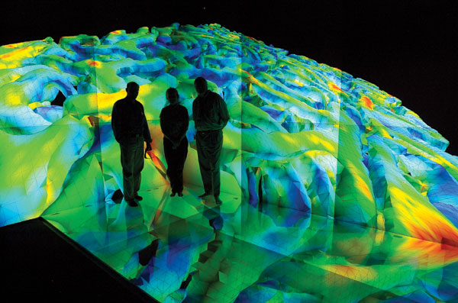
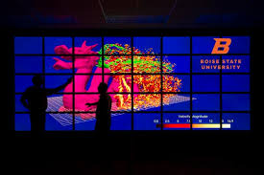
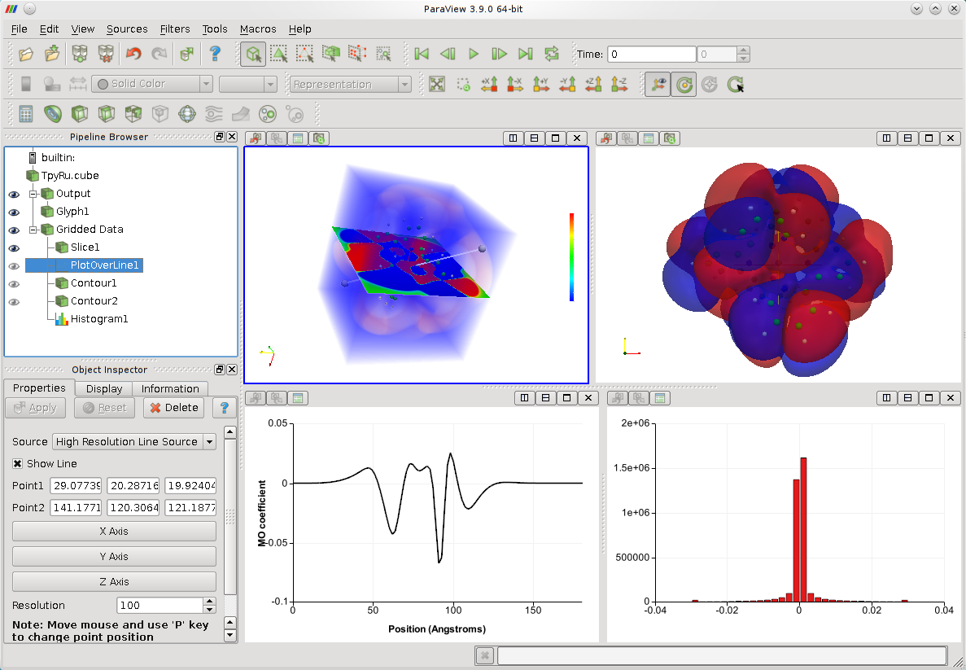
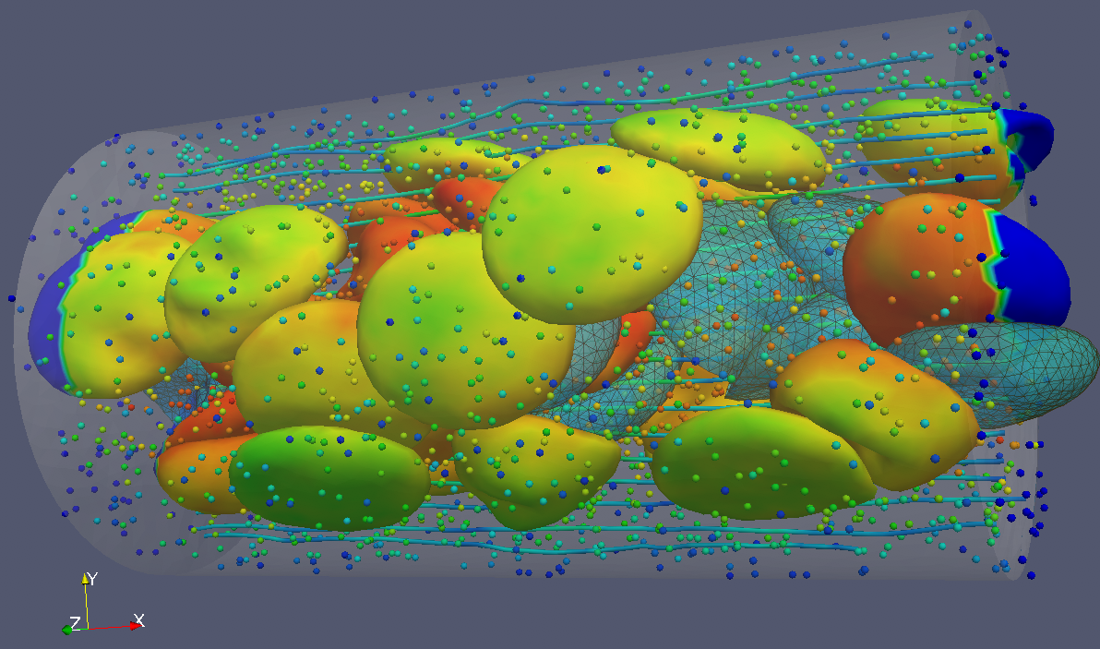
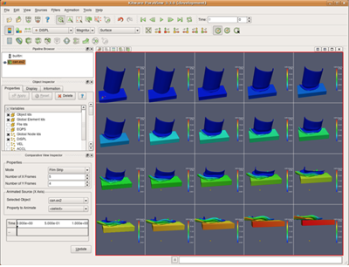
ParaView is an open-source, multi-platform, data analysis and visualization application for analyzing extremely large datasets using distributed memory computing resources.

Slide 4
Computational Model Builder
PointsBuilder – point-based information
SceneBuilder – scene geometry
ModelBuilder – simulation centric topology
SimBuilder – complete simulation model
MeshViewer – simulation meshes
ParaView – post processing

Slide 5
Research Team
Joachim Pouderoux (Technical Expert)
Mathieu Westphal (R&D Engineer)
Tristan Coulange (R&D Engineer)
Julien Jomier (Technical Leader)

Slide 6
Role and WP
VTK/ParaView training course
Sept 6-7, 2016
Lyon, France
Attended by 18 participants
Hosting of secondments
Training on efficient programming for ParaView
Expertise in developing ParaView Plugin
Interfacing with CMB

